Slide 1
Drone Setup
Parrot Bebop2
Android Studio
JoyStick

Slide 2
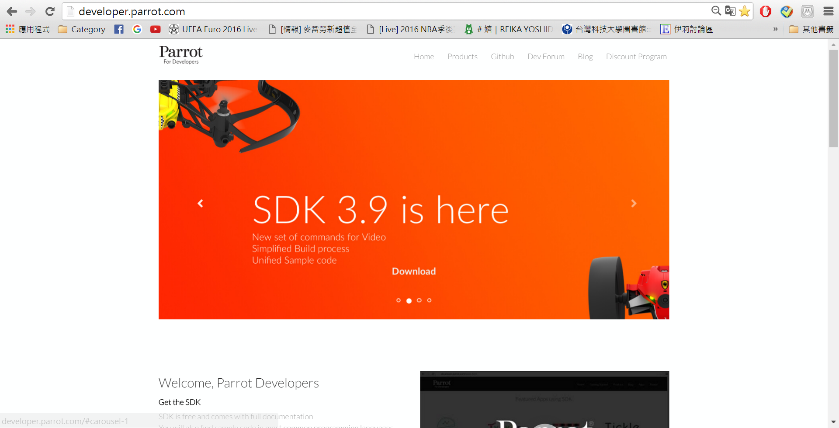
The Web of Parrot Developers
Parrot For Developers: http://developer.parrot.com/

Slide 3
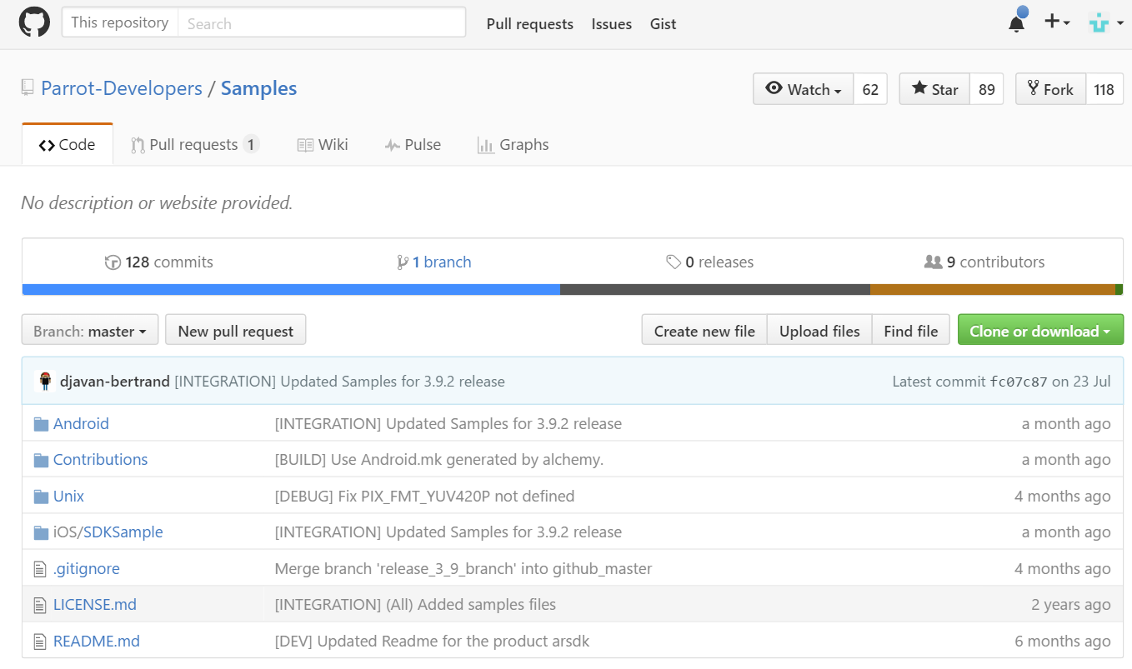
Github for Download(1)
https://github.com/Parrot-Developers/Samples

Slide 4
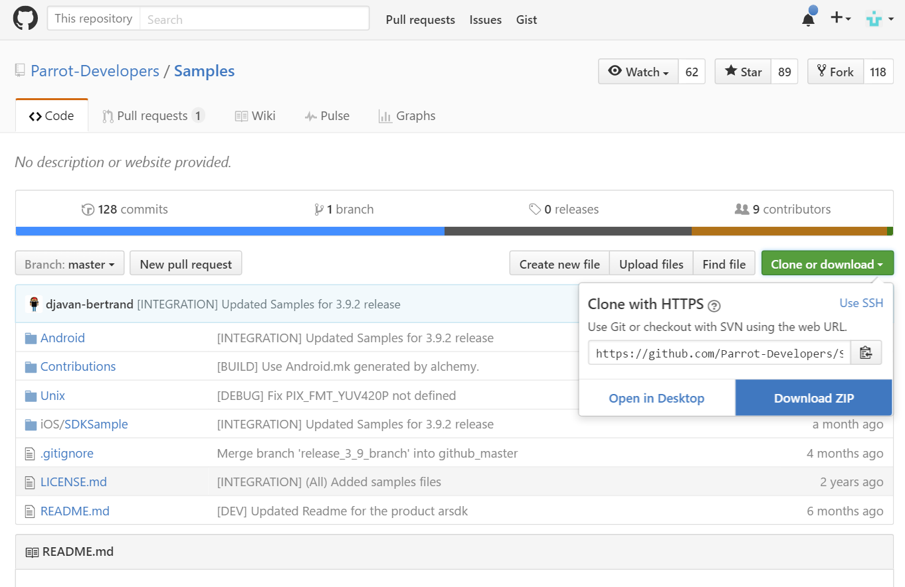
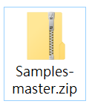
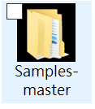
Github for Download(2)

Slide 5
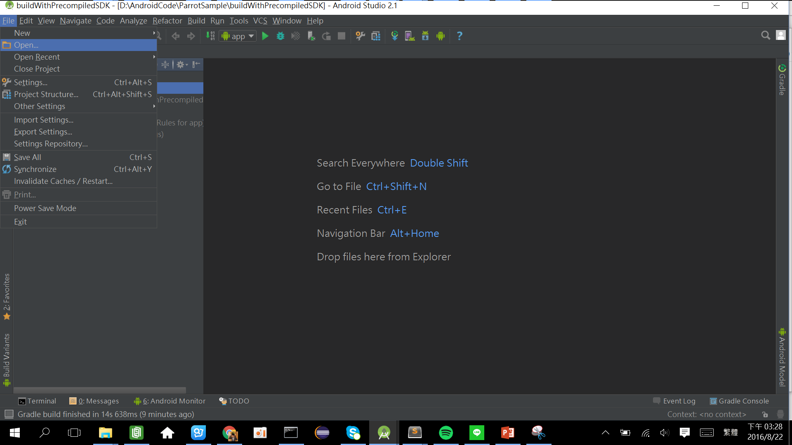
Open Project in Android Studio
Open Android Studio > File > Open

Slide 6
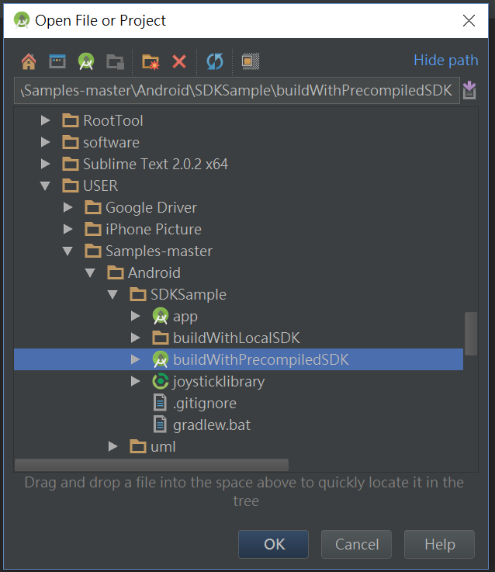
Build with precompiledSDK
Find the Path of buildWithPrecompiledSDK
Inside “Sample-master/Android/SDKSample”
Click Ok
Maybe exist some problems (Gradle version is different), follow Android Studio to fix it.

Slide 7
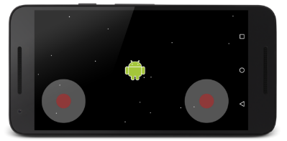
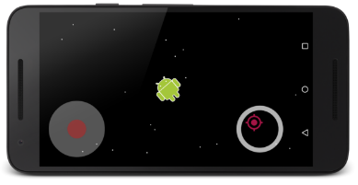
JoyStick
Import Library into Android Studio

Slide 8
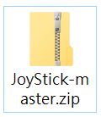
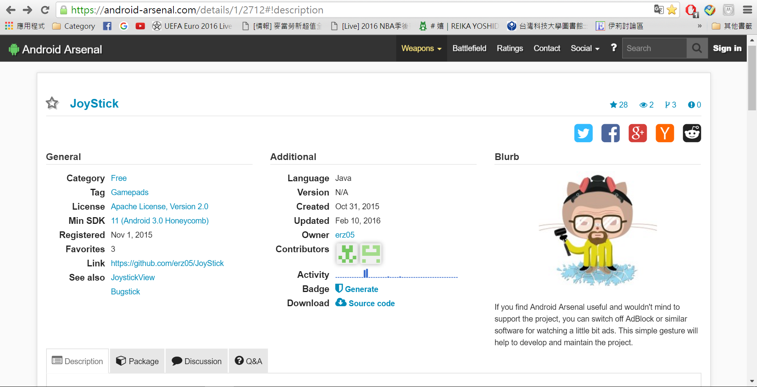
Download Source Code
File: JoyStick-master.zip
Size: 3.3M

Slide 9
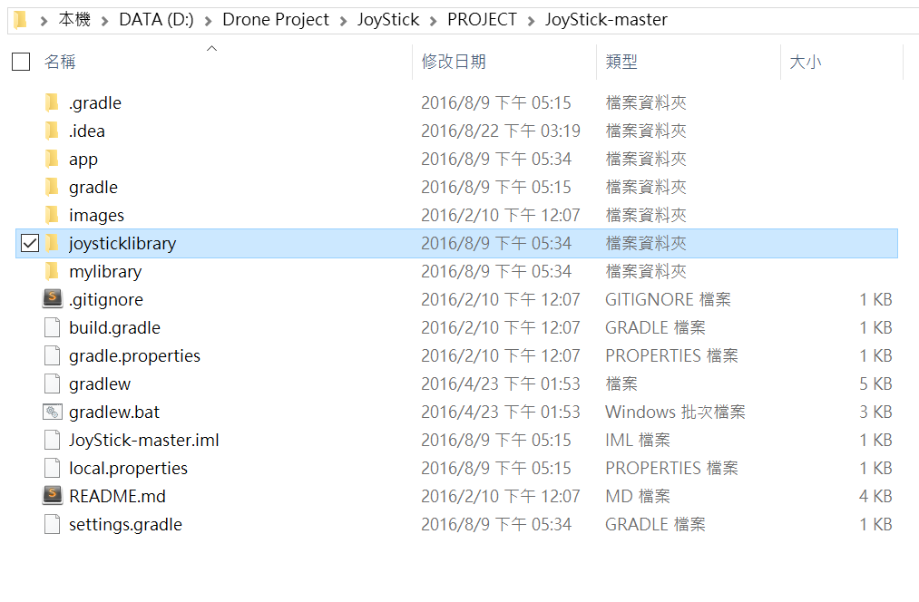
Copy JoyStick Library to Your Project
Open the Directory of JoyStick-master in explorer.
Select the Directory: joysticklibrary.
Copy It to Your Drone Project!

Slide 10
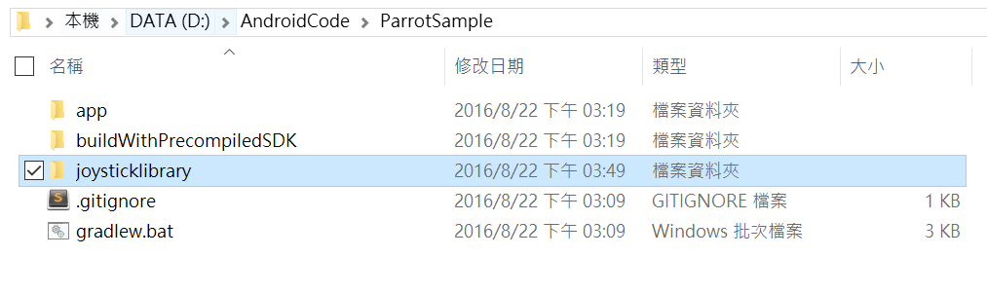
Copy JoyStick Library to Your Project
Paste it in the same site of Your Project of app

Slide 11
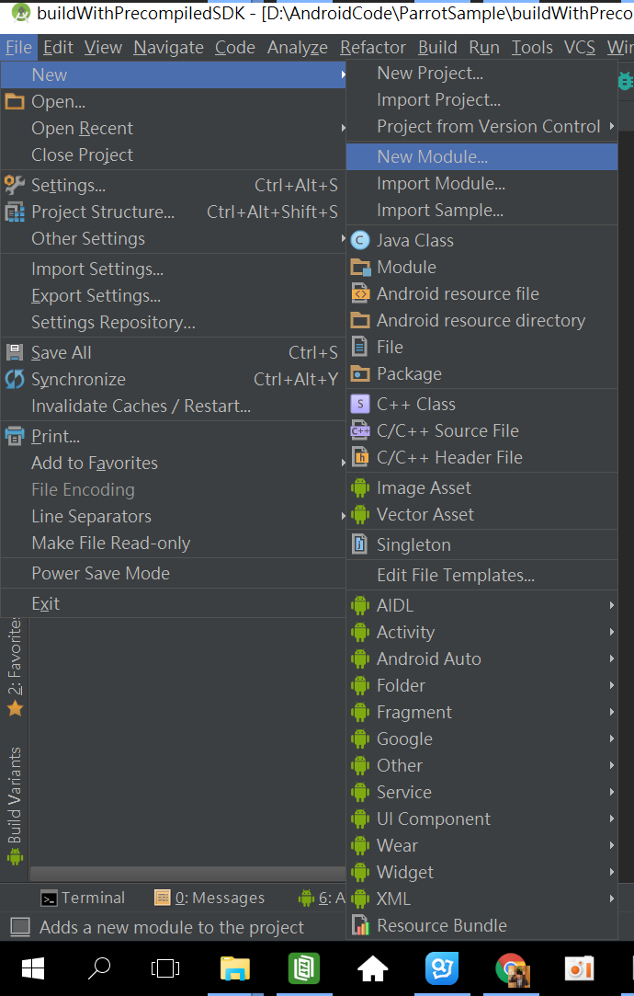
Import Library to your Project
File > New > New Module…

Slide 12
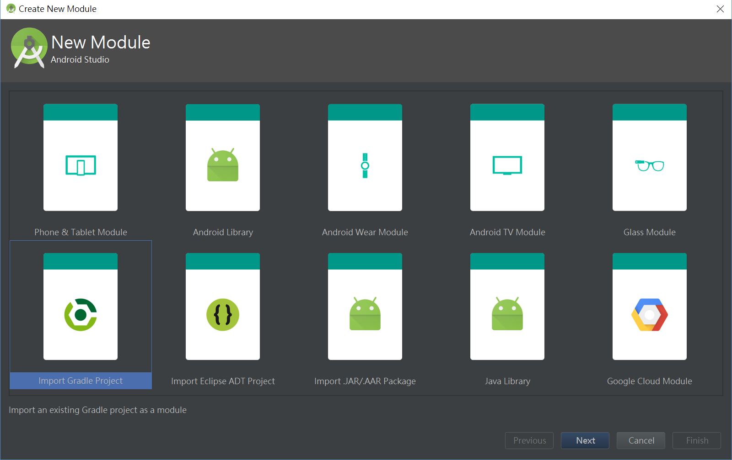
Select: Import Gradle Project

Slide 13
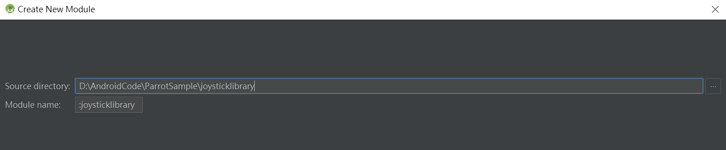
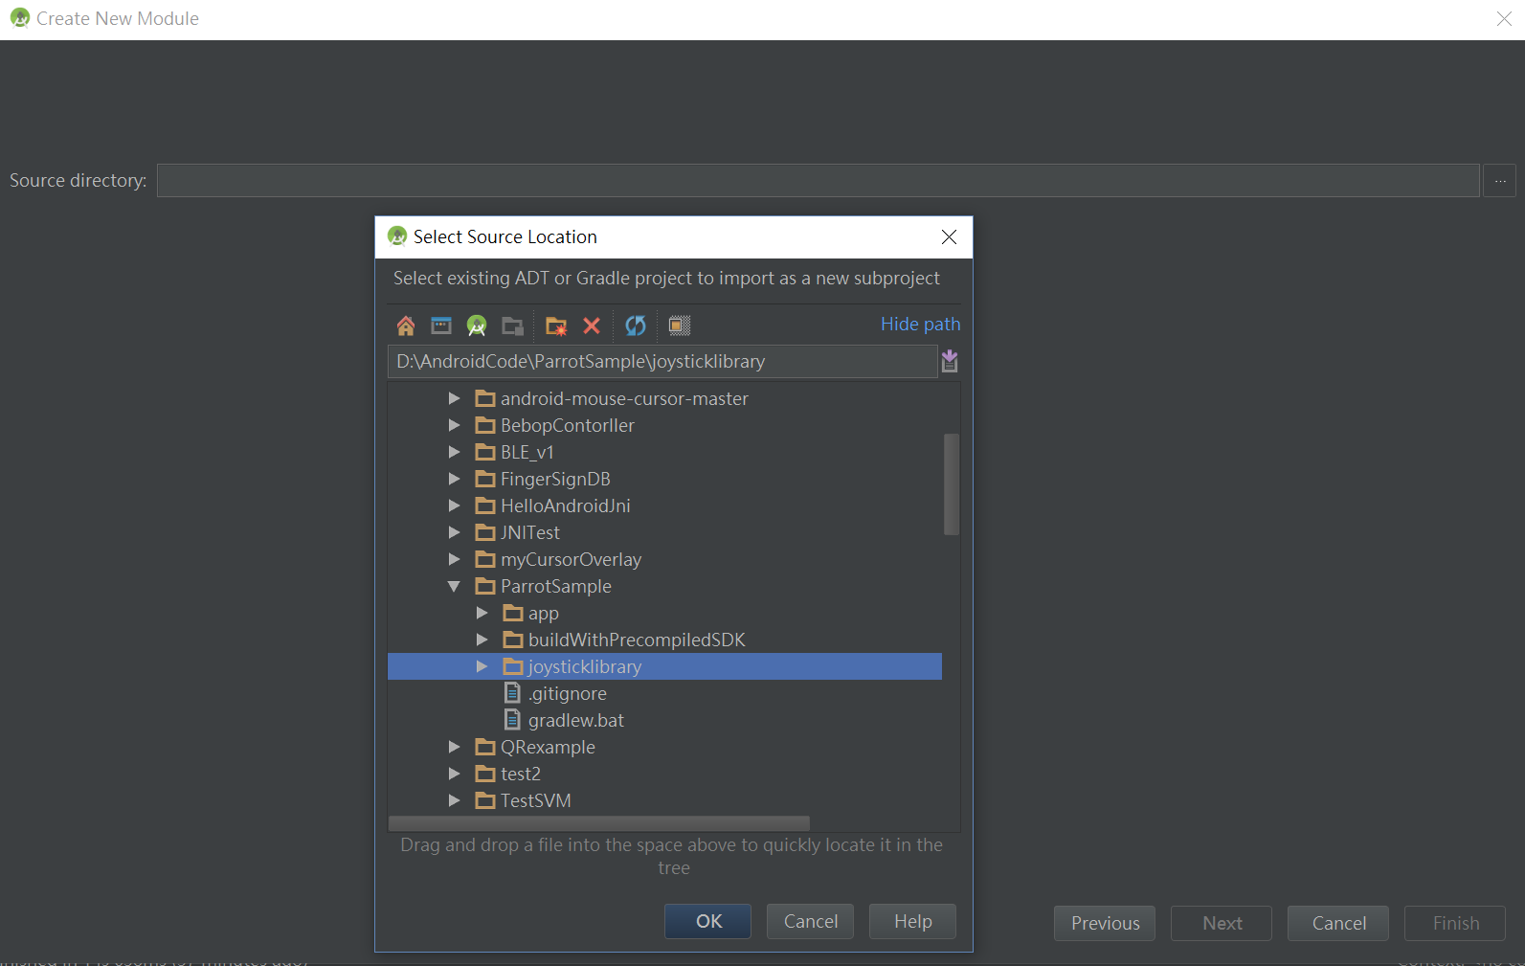
Select Source Location
Find the joysticklibrary.
Click Finish.

Slide 14
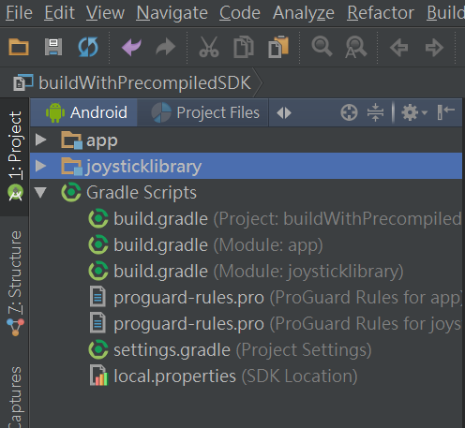
Success to import joysticklibrary

Slide 15
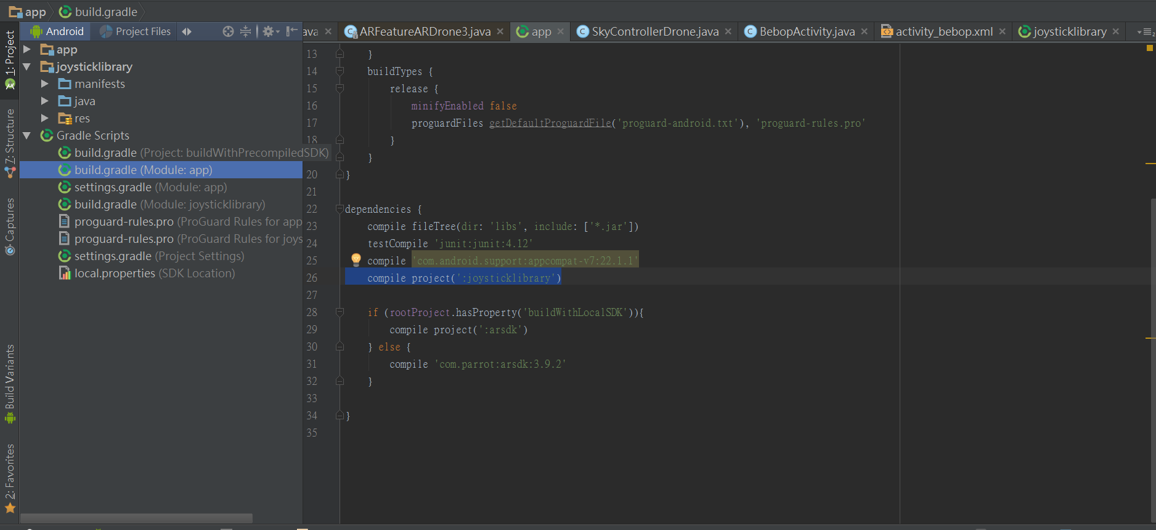
Add dependency Compile Project
Add
In Gradle Scripts > build.gradle(Module: app) > dependencies {}
compile project(':joysticklibrary')

Slide 16
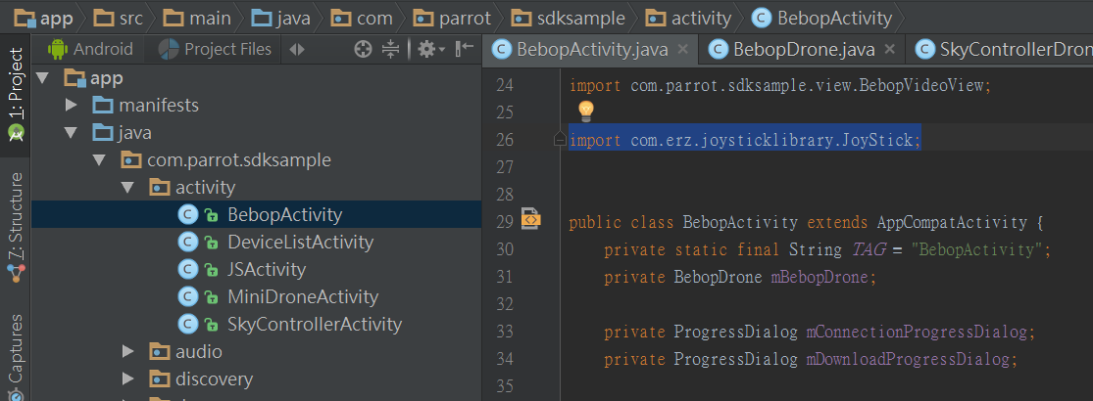
Import joystick inside your Project Activity
Add
import com.erz.joysticklibrary.JoyStick;

